Slide 1

Tuples and Sets in Python

Slide 2
Creating Tuples
Tuples are ordered collections of items enclosed in parentheses. They are immutable.
Example:
example_tuple = (1, 2, 3, 'hello')

Slide 3
Basic Tuple Operations
Tuples support indexing, concatenation, and repetition but cannot be modified.
Example:
(1,2) + (3,4) → (1,2,3,4)

Slide 4
Indexing and Slicing in Tuples
Tuples allow accessing elements using index positions and slicing.
Example:
t = (10, 20, 30)
t[1] → 20
t[:2] → (10, 20)

Slide 5
Built-In Functions Used on Tuples
Common functions include len(), max(), min(), and sum() for numeric tuples.
Example:
max((5,10,15)) → 15

Slide 6
Relation between Tuples and Lists
Lists are mutable, while tuples are immutable. Tuples can be converted to lists and vice versa.
Example:
tuple([1,2,3]) → (1,2,3)

Slide 7
Relation between Tuples and Dictionaries
Tuples can be used as dictionary keys because they are immutable.
Example:
d = {(1,2): 'value'}

Slide 8
Tuple Methods
Tuples support methods like count() and index() to retrieve data.
Example:
(1,2,3,2).count(2) → 2

Slide 9
Using zip() Function
The zip() function combines multiple iterables element-wise.
Example:
list(zip([1,2], ['a','b'])) → [(1,'a'), (2,'b')]

Slide 10
Sets
Sets are unordered collections of unique elements, defined using curly brackets.
Example:
{1,2,3,3} → {1,2,3}

Slide 11
Set Methods
Common set methods include add(), remove(), union(), and intersection().
Example:
{1,2}.union({2,3}) → {1,2,3}

Slide 12
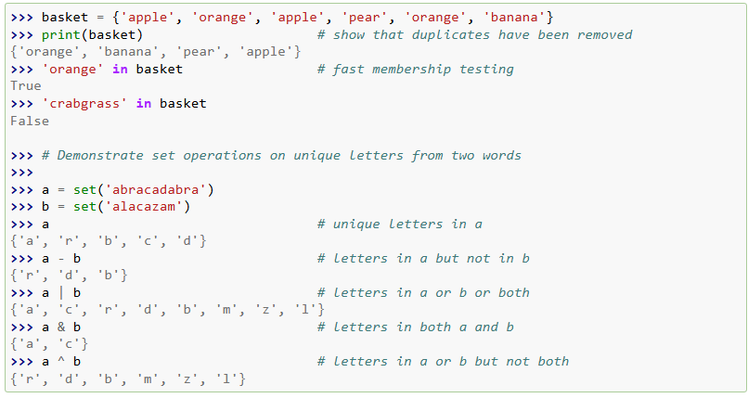

Slide 13
Traversing of Sets
Sets can be iterated using loops since they are iterable.
Example:
for i in {1,2,3}: print(i)

Slide 14
Frozenset()
A frozenset is an immutable version of a set and does not allow modifications.
Example:
frozenset([1,2,3]) → frozenset({1,2,3})

Slide 15
The End

